Slide 1
Promoting public-private partnership and collaboration with HEIs
Barbara Karleuša, Nevena Dragičević
University of Rijeka, Faculty of Civil Engineering
Workshop on innovative practices in the EU water sector:
barriers and opportunities, Vienna, 10/05/2019
This project has been funded with support from the European Commission. This publication reflects the views only of the author, and the Commission cannot be held responsible for any use which may be made of the information contained therein.

Slide 2
Content
1. Introduction
2. Collaboration on projects:
2.1. EU funded research projects (partners or experts)
2.1.1. DRINKADRIA
2.1.2. RAINMAN
2.2. Bilateral project (Croatia – Japan): Risk Identification and Land – Use Planning for Disaster Mitigation of Landslides and Floods in Croatia
2.3. Other types of projects (research projects and professional work)
3. Collaboration with firms that develop specialised software
4. Collaboration with stakeholders:
4.1. Committee for Cooperation with the Community and the Industry
4.2. Practical teaching / field work
4.3. Participation of stakeholders in teaching (lectures)
4.4. UNIRIFCE Open day
5. Collaboration with other HEIs
6. Collaboration in education of young generations (kindergartens, schools, …)
Strengthening of master curricula in water resources management
for the Western Balkans HEIs and stakeholders
www.swarm.ni.ac.rs

Slide 3
public-private partnership
1. Introduction
UNIRIFCE Mission
…. Mission is also to promote civil engineering profession and raise awareness about its significance for sustainable development within wider community by simultaneously promoting academic principles and contributing to development of the city, region and Republic of Croatia….
UNIRIFCE Vision
… The Faculty will also promote cooperation with public institutions and business partners and be involved in European and world research and higher education field through international cooperation and mobility programmes….
PUBLIC
Common interest
PRIVATE
Strengthening of master curricula in water resources management
for the Western Balkans HEIs and stakeholders
www.swarm.ni.ac.rs

Slide 4
2. Collaboration on projects
EU funded research projects (partners or experts):
                DRINKADRIA
                RAINMAN
Bilateral project (Croatia – Japan): Risk Identification and Land – Use
Planning for Disaster Mitigation of Landslides and Floods in Croatia
Other types of projects:
                Research project
                Professional work
Strengthening of master curricula in water resources management
for the Western Balkans HEIs and stakeholders
www.swarm.ni.ac.rs

Slide 5
2.1. EU funded research projects
(partners or experts)
CC WATER S, South East Europe, Transnational cooperation programme; SEE-TC, (2009-2012)
ŽIVLJENJE – VODA! / ŽIVOT – VODA! – ŽIVO
European Regional Development Fund – ERDF Operational Programme
Slovenija – Hrvatska (OP SLO-HR) 2007-2013, (2014-2015)
DRINKADRIA - Networking for Drinking Water Supply in Adriatic Region
IPA ADRIATIC CBC Programme 2007-2013, (2013-2016)
INTEGRATED HEAVY RAIN RISK MANAGEMENT - RAINMAN
INTERREG Central Europe, (2018 - …)
Strengthening of master curricula in water resources management
for the Western Balkans HEIs and stakeholders
www.swarm.ni.ac.rs

Slide 6

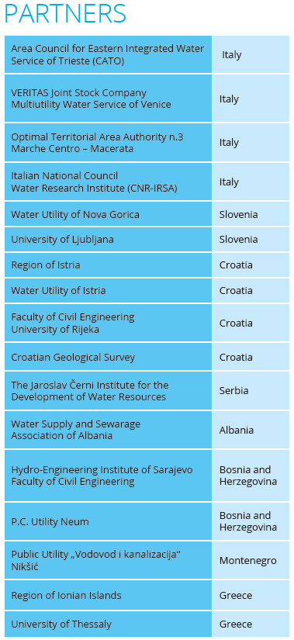
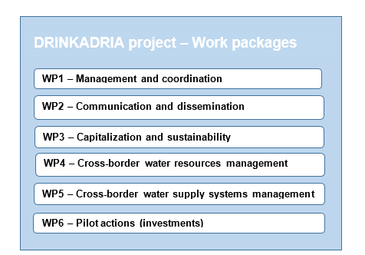
2.1.1. DRINKADRIA
The partnership:
water utilities (5 partners),
authorities (4 partners),
research institutions (7 partners) and
one association.
6.600.000,00 Eur
November, 2013 – October, 2016
http://drinkadria.fgg.uni-lj.si/
Strengthening of master curricula in water resources management
for the Western Balkans HEIs and stakeholders
www.swarm.ni.ac.rs

Slide 7
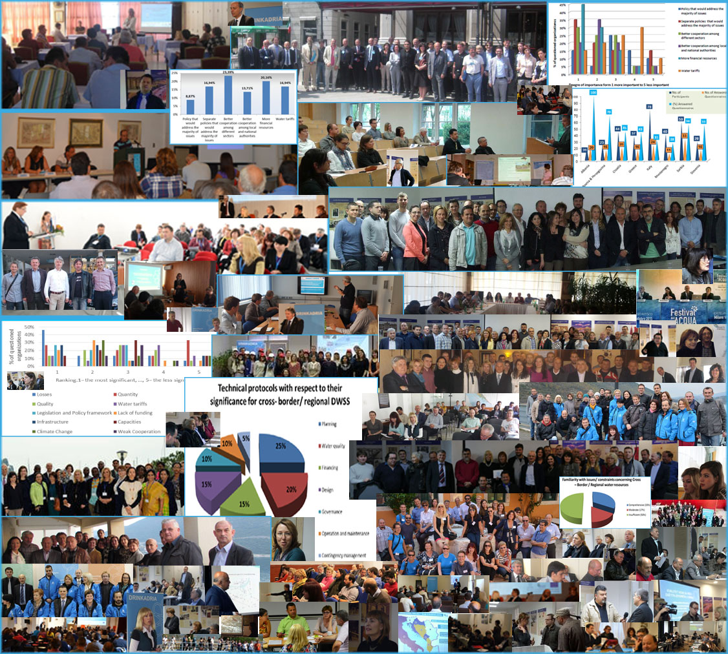
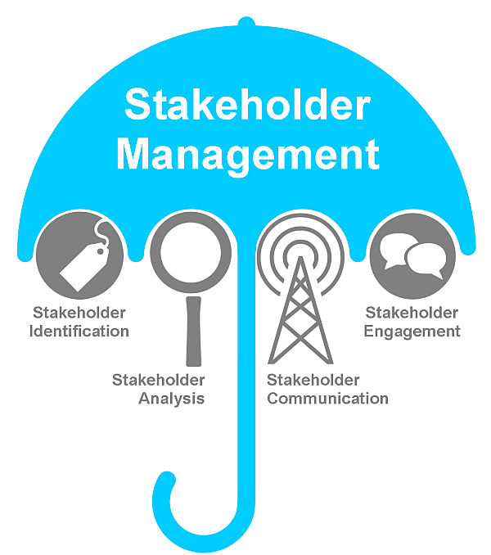
DRINKADRIA – WP3
Strengthening of master curricula in water resources management
for the Western Balkans HEIs and stakeholders
www.swarm.ni.ac.rs

Slide 8
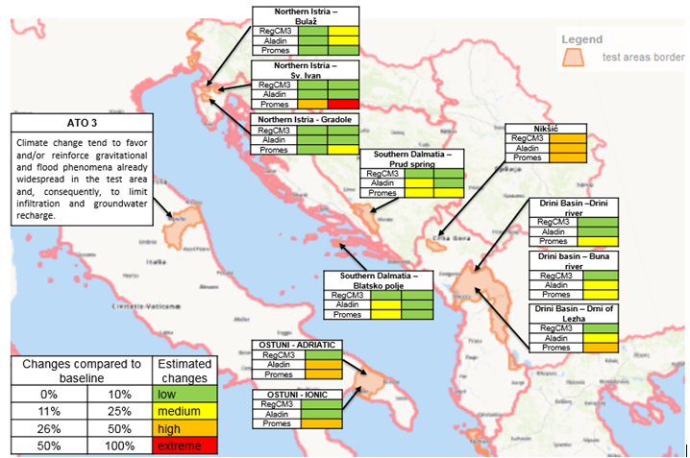
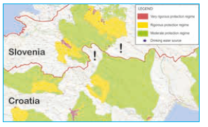
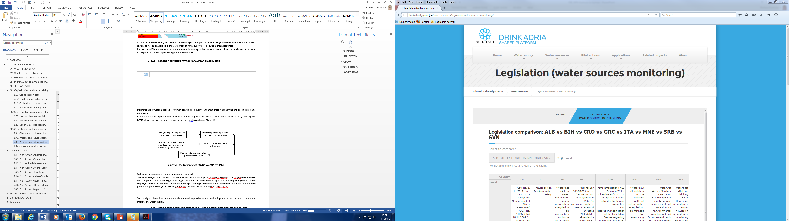
DRINKADRIA – WP4
Strengthening of master curricula in water resources management
for the Western Balkans HEIs and stakeholders
www.swarm.ni.ac.rs

Slide 9


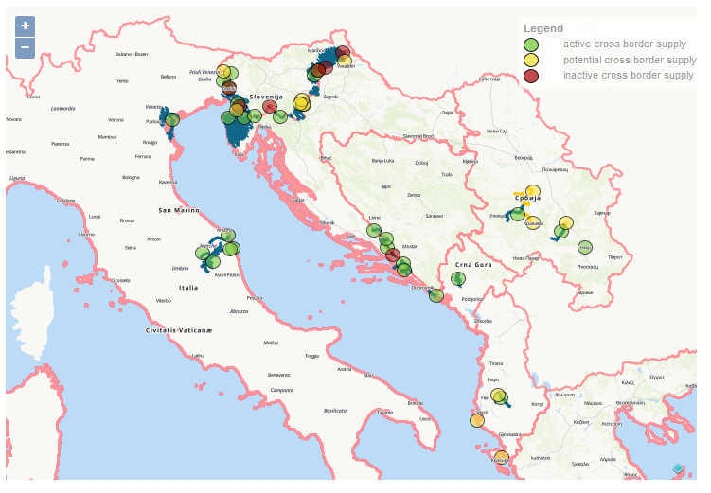
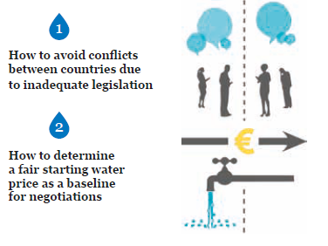
DRINKADRIA – WP5
Strengthening of master curricula in water resources management
for the Western Balkans HEIs and stakeholders
www.swarm.ni.ac.rs

Slide 10
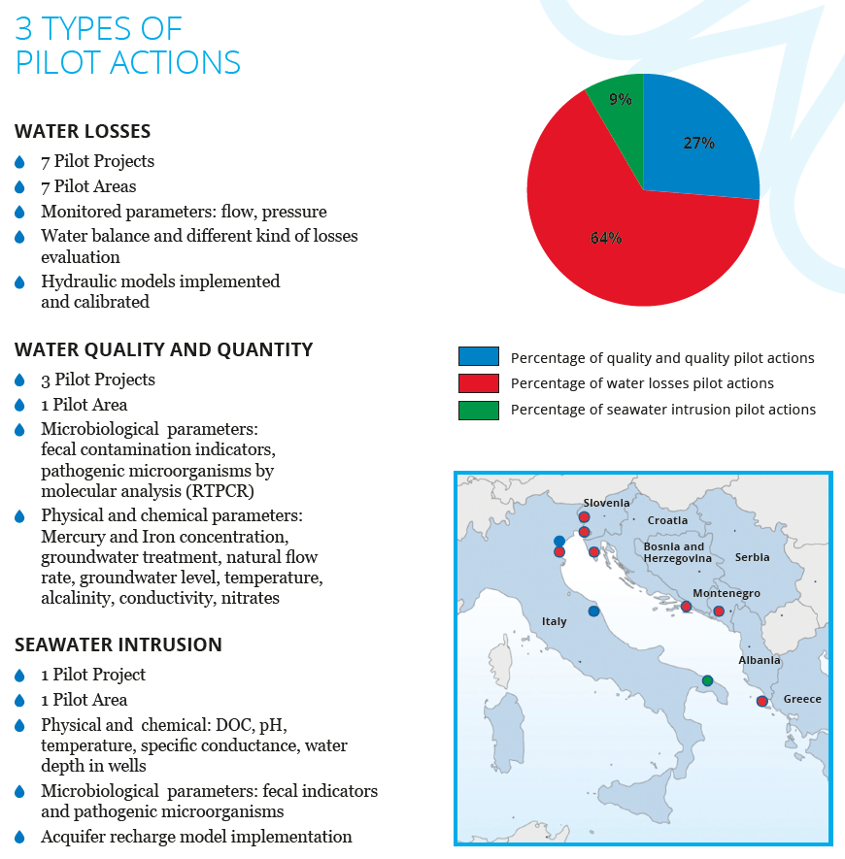
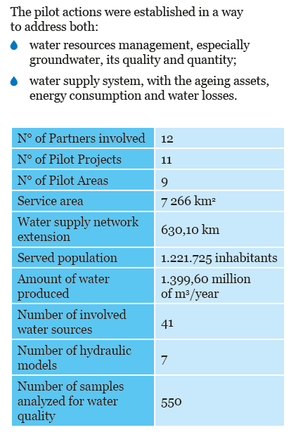
DRINKADRIA – WP6
Strengthening of master curricula in water resources management
for the Western Balkans HEIs and stakeholders
www.swarm.ni.ac.rs

Slide 11

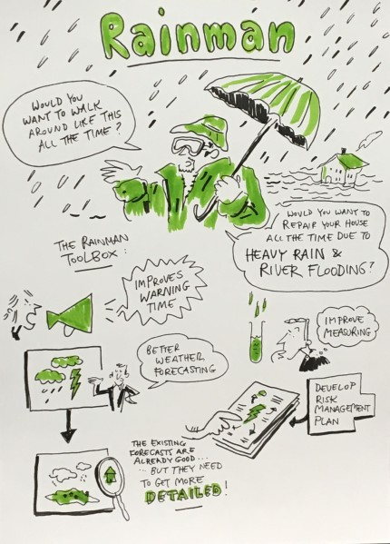
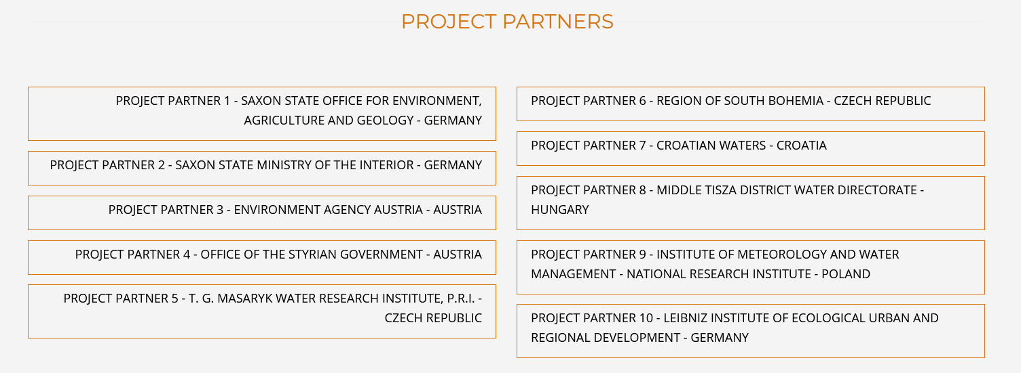
2.1.2. RAINMAN
INTEGRATED HEAVY RAIN RISK MANAGEMENT
Collaboration with Croatian Waters – UNIRIFCE and Croatian Meteorological and Hydrological Service as experts
https://www.interreg-central.eu/Content.Node/RAINMAN.html
Strengthening of master curricula in water resources management
for the Western Balkans HEIs and stakeholders
www.swarm.ni.ac.rs

Slide 12
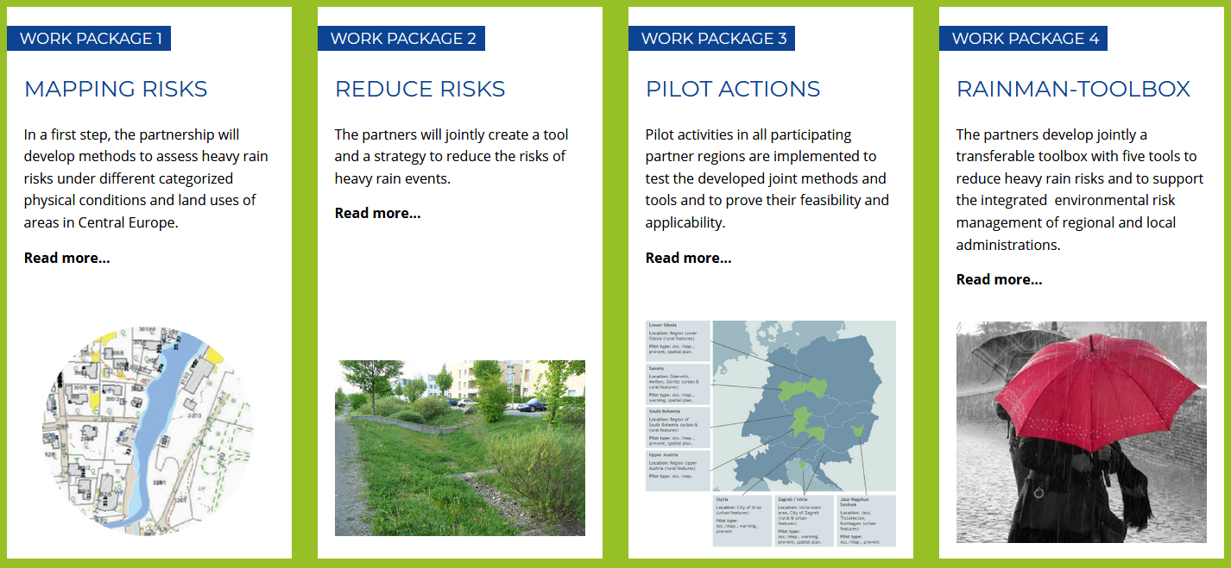
Strengthening of master curricula in water resources management
for the Western Balkans HEIs and stakeholders
www.swarm.ni.ac.rs

Slide 13
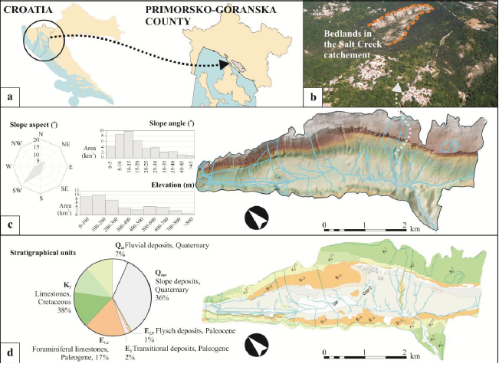
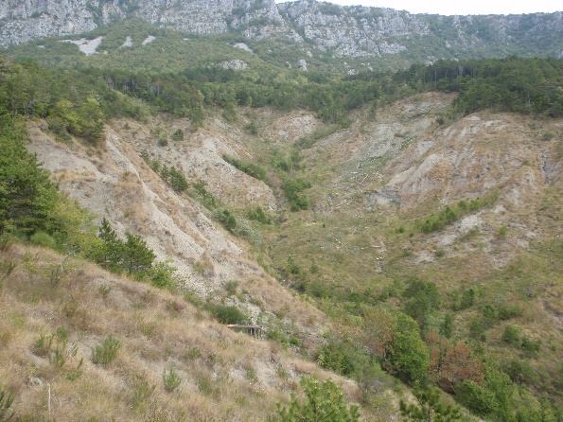
2.2. Bilateral Croatian – Japanese Project on:
Risk Identification and Land – Use Planning
for Disaster Mitigation of Landslides and Floods in Croatia
Strengthening of master curricula in water resources management
for the Western Balkans HEIs and stakeholders
www.swarm.ni.ac.rs

Slide 14
Included institutions in Croatia:
University of Rijeka – Faculty of Civil engineering
University of Zagreb
University of Split
Croatian Geological Survey
Croatian Waters
Croatian Hydrological and Meteorological Survey
Local authorities
Included institutions in Japan:
Kyoto University, Disaster Prevention Research Institute (DPRI)
Niigata University
International Consortium on Landslides (ICL)
Financed and supported by:
JST (Japan Agency for Science and Technology)
JICA (Japan International Cooperation Agency),
Ministry of Science, Education and Sport Croatia
Strengthening of master curricula in water resources management
for the Western Balkans HEIs and stakeholders
www.swarm.ni.ac.rs

Slide 15
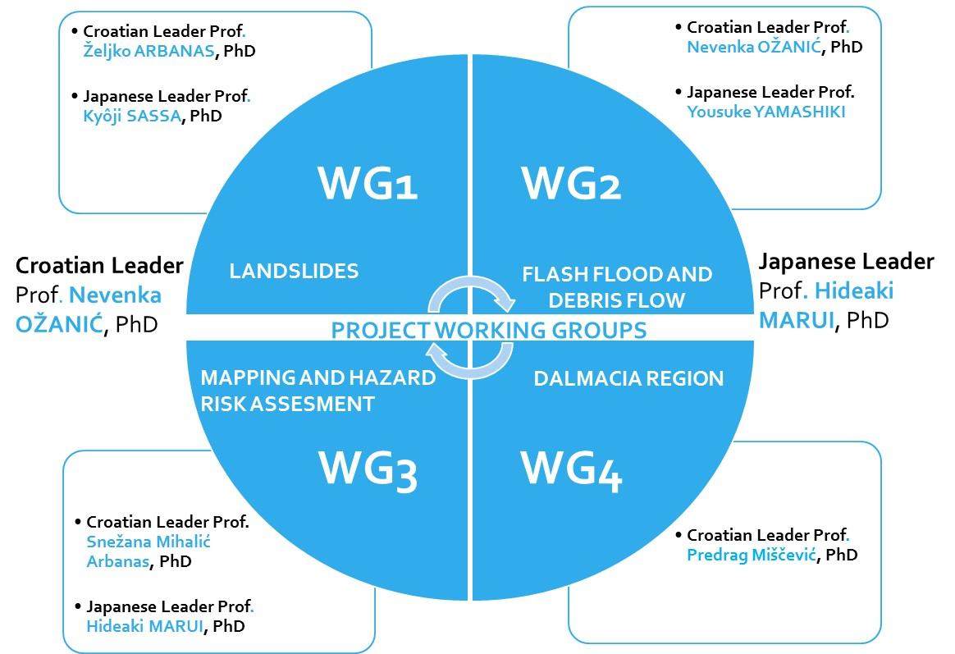
Strengthening of master curricula in water resources management
for the Western Balkans HEIs and stakeholders
www.swarm.ni.ac.rs

Slide 16
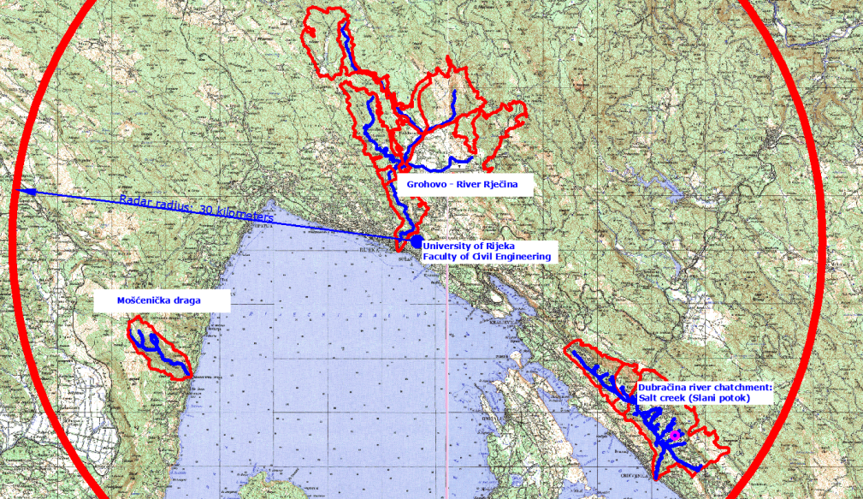
PROJECT MAIN
ACTIVITIES:
Definition of hazard zones using a methodology for assessing susceptibility and hazards based on local geological, hydrological, hydraulic and landslide conditions
Establishment and development of early warning systems for landslides, flash-flood and debris-flow adapted to hydrological and geological conditions in Croatia
Development of risk mitigation measures that can be instituted through urban planning
Dissemination and use of the results should ensure significant benefits for the local and regional communities that are directly and indirectly threatened by landslides, flash-floods and debris-flow.
Strengthening of master curricula in water resources management
for the Western Balkans HEIs and stakeholders
www.swarm.ni.ac.rs

Slide 17
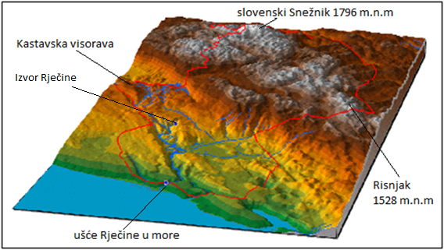
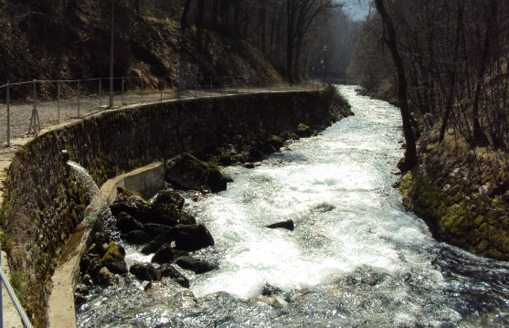
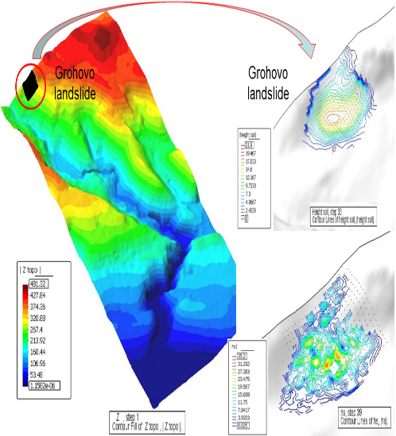
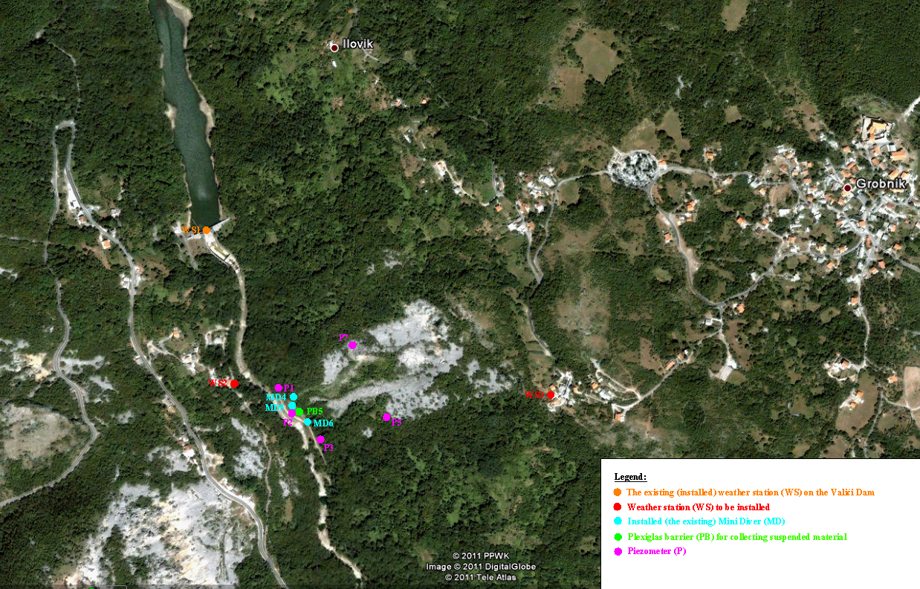
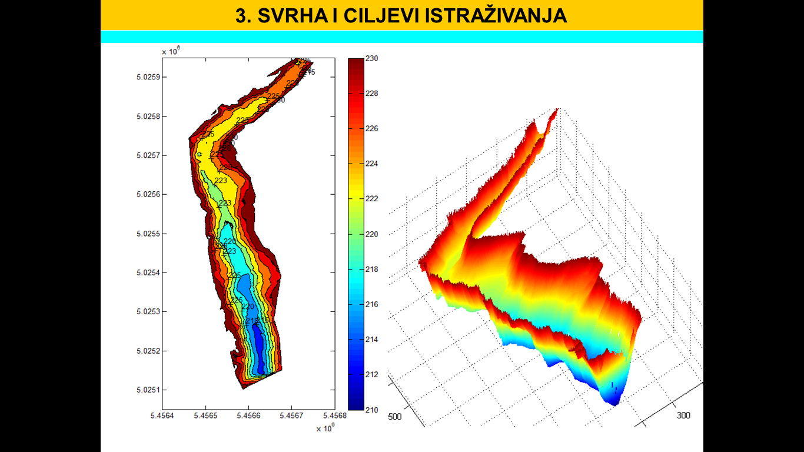
ONE of RESEARCH AREAS
Catchment Črnomerec, Landslide Kostanjek, Zagreb
Catchment Rječina, Landslide Grohovo, Rijeka
Catchment Dubračina, Sub-catchment Slani Potok, Vinodl Valley
Catchment Mošćenička Draga, Mošćenička Draga
Rock Falls around area of Omiš and Duće
Catchment Sutina Karakašica, Split
Strengthening of master curricula in water resources management
for the Western Balkans HEIs and stakeholders
www.swarm.ni.ac.rs

Slide 18
2.3. Other projects
Research projects:
    Funded by the Ministry of science, education and sport
    Funded by the Croatian Science Foundation
    Funded by the University – priority given to „smart specialisation” projects
    Funded by:
      National (nature) park:
                Hydrodinamics of Plitvice Lakes
                Monitoring of morphological changes in Korana River)
Professional work (projects, studies…)
Participation in expert groups, councils, …
Strengthening of master curricula in water resources management
for the Western Balkans HEIs and stakeholders
www.swarm.ni.ac.rs

Slide 19

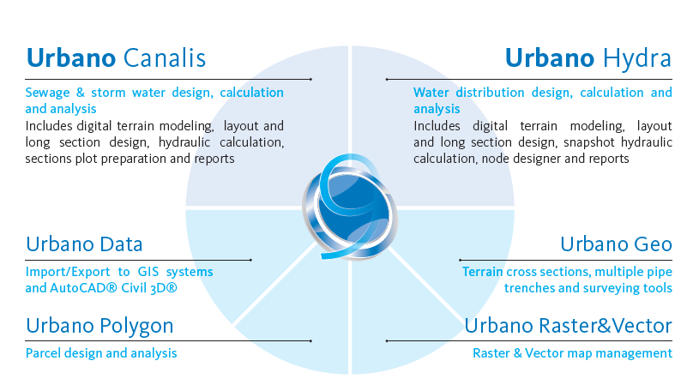
3. Collaboration with firms that develop specialised software – Studio ARS
http://www.studioars.com/en/urbano_9_canalis/146/2
Strengthening of master curricula in water resources management
for the Western Balkans HEIs and stakeholders
www.swarm.ni.ac.rs

Slide 20
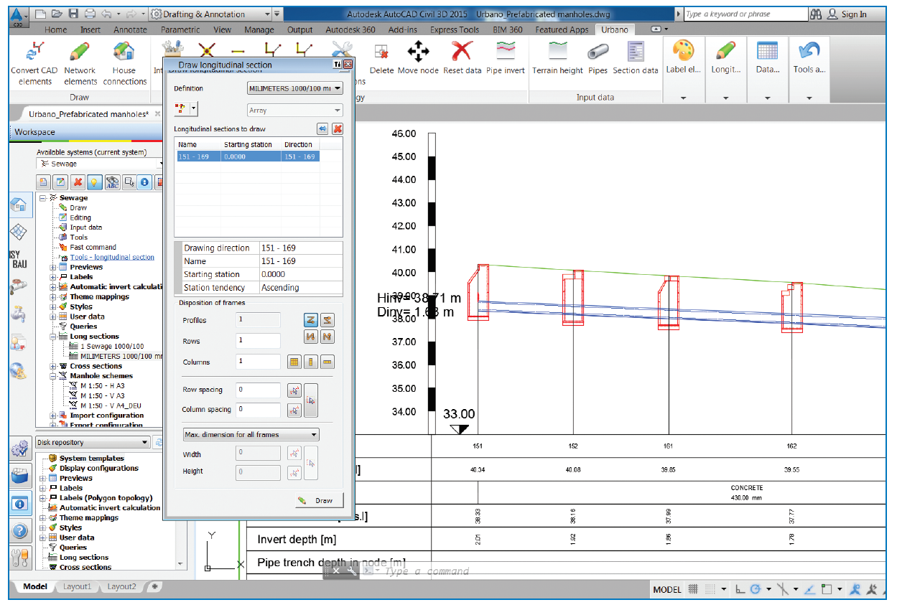
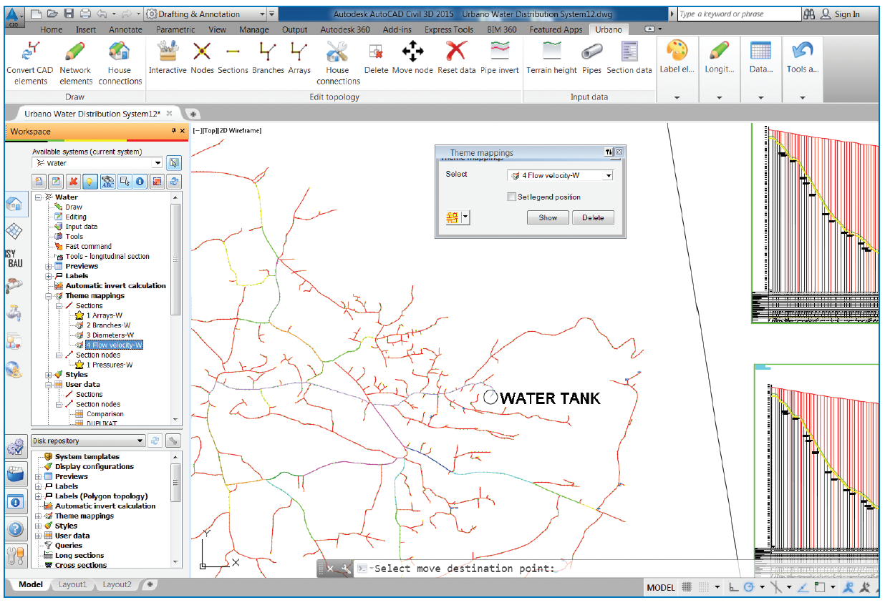
Help in developing (initial stage) and testing the software
Use for students projects (Master Thesis) – for free
Strengthening of master curricula in water resources management
for the Western Balkans HEIs and stakeholders
www.swarm.ni.ac.rs

Slide 21
4. Collaboration with stakeholders:
Committee for Cooperation with the Community and the Industry
Practical teaching / field work
Participation of stakeholders in teaching (lectures)
Open day
LLL programmes and other educations for stakeholders (some on their request)
Strengthening of master curricula in water resources management
for the Western Balkans HEIs and stakeholders
www.swarm.ni.ac.rs

Slide 22
4.1. Committee for Cooperation with the Community and the Industry
Rulebook on Cooperation with the Community and the Industry, UNIRIFCE, 2013.
Commitee:
  Vice dean – for bussines relationships
  2 teachers
  4 external members from the Community and Industry (1 of them is the president of the UNIRIFCE Alumni club)
Strengthening of master curricula in water resources management
for the Western Balkans HEIs and stakeholders
www.swarm.ni.ac.rs

Slide 23
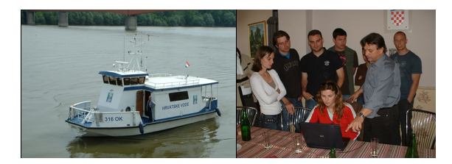
4.2. Collaboration with stakeholders:
Practical teaching / field work
The ship of Croatian Waters (Agency) on Danube River on which students participated to measurements carried out by Croatian Meteorological and Hydrological Service
and measured data elaboration, 2009.
Strengthening of master curricula in water resources management
for the Western Balkans HEIs and stakeholders
www.swarm.ni.ac.rs

Slide 24
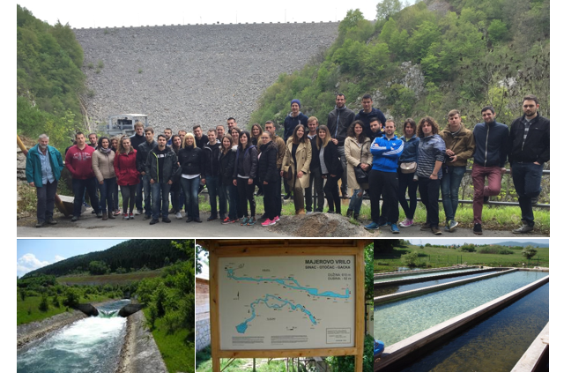
Field visit : water resources and water management systems (HEP) in Lika and Gacka rivers basins, 2016.
Strengthening of master curricula in water resources management
for the Western Balkans HEIs and stakeholders
www.swarm.ni.ac.rs

Slide 25
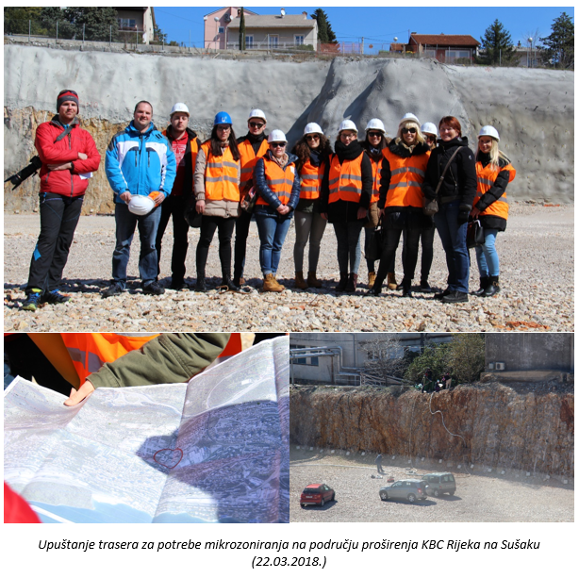
Students visit during groundwater tracing (carried out by Croatian Geological Survey, with presence of Croatian Waters representative), Rijeka, 2018.
Strengthening of master curricula in water resources management
for the Western Balkans HEIs and stakeholders
www.swarm.ni.ac.rs

Slide 26
4.3.Participation of stakeholders in teaching (lectures)
AS TEACHERS – EXTERNAL EXPERTS, whole courses
AS INVITED LECTURERS:
Presentation of:
Croatian Waters
  Water Utilities
  Waste Management Companies
Software
....
Strengthening of master curricula in water resources management
for the Western Balkans HEIs and stakeholders
www.swarm.ni.ac.rs

Slide 27
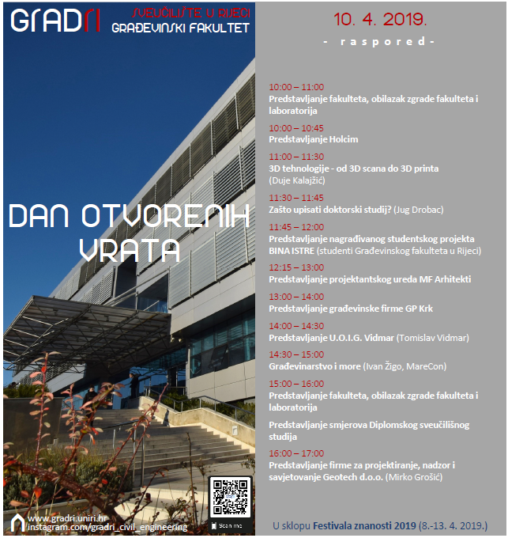
4.4. UNIRIFCE Open day
Strengthening of master curricula in water resources management
for the Western Balkans HEIs and stakeholders
www.swarm.ni.ac.rs

Slide 28
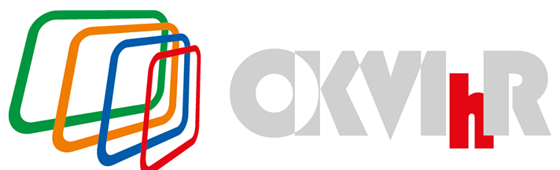
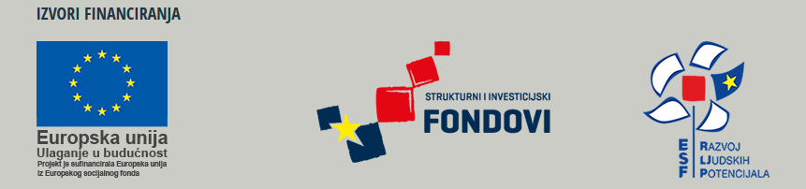
5. Collaboration with other HEIs
Development and preparation of the Croatian Qualifications Framework in Higher Education of Civil Engineers (UNIRIFCE, UNIZG, UNIOS, UNIST)
The aim of the project was to align civil engineering studies with new needs and qualification standards to achieve a socially acceptable level of knowledge - new tools, new education models that are aligned with strategic and development goals and labor market needs.
Strengthening of master curricula in water resources management
for the Western Balkans HEIs and stakeholders
www.swarm.ni.ac.rs

Slide 29
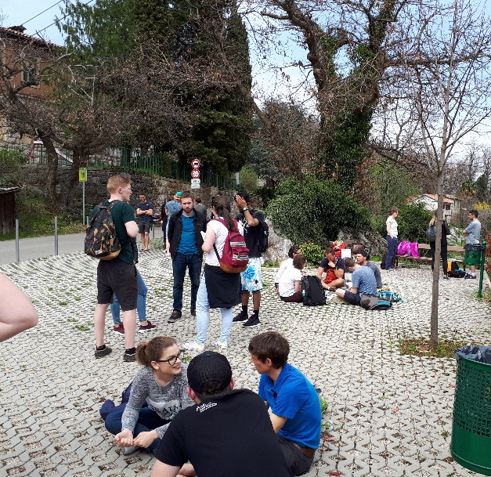
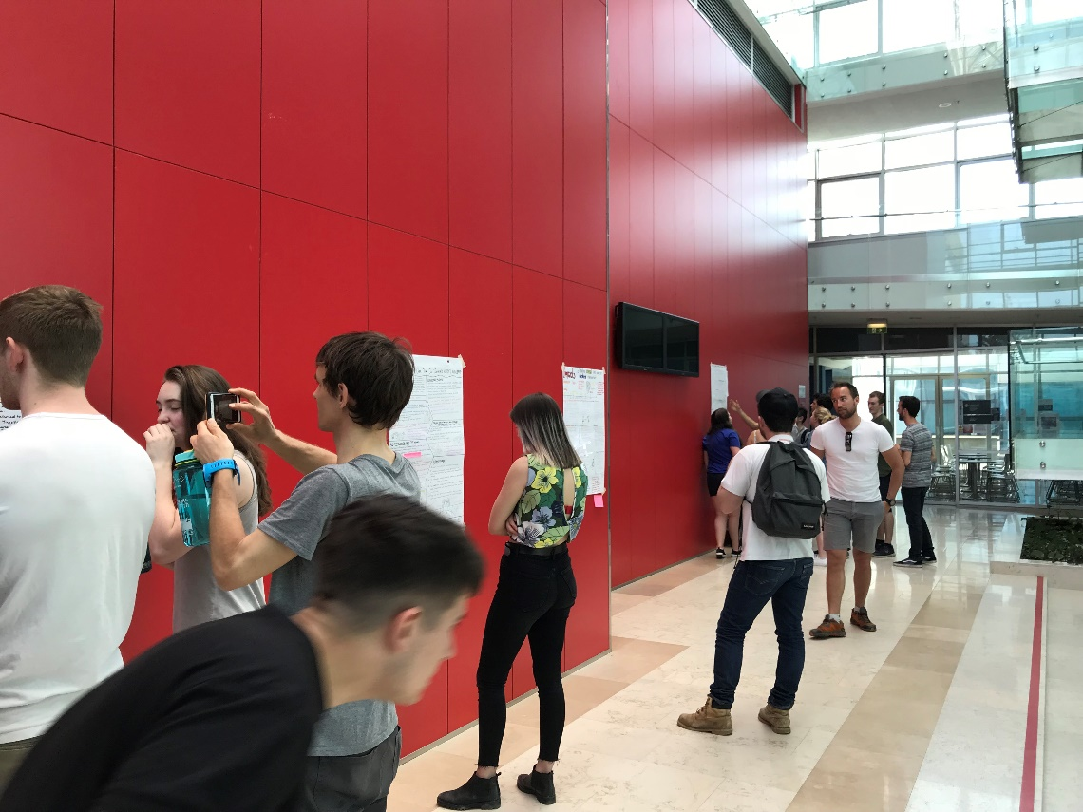
5. Collaboration with other HEIs
UNIVERSITY OF LANCASTER, UK, Water and environmental management in mediteranean contex - FIELD COURSE
Collaboration with UNIRIFCE master students within the Water management course
Strengthening of master curricula in water resources management
for the Western Balkans HEIs and stakeholders
www.swarm.ni.ac.rs

Slide 30
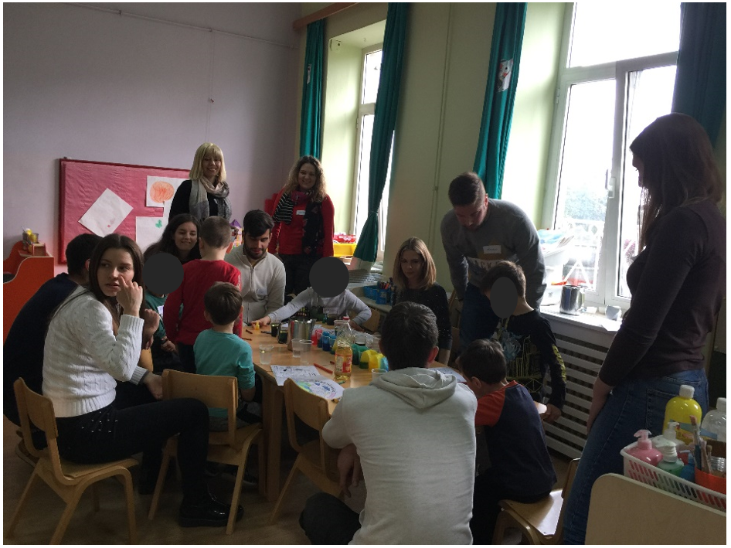
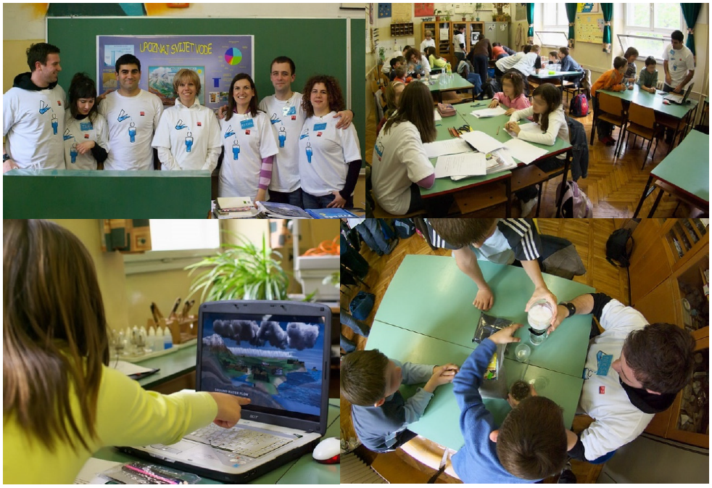
6. Collaboration in education of young generations (kindergartens, schools, …)
Kindergarten, 2019. Elementary school, 2008.
Strengthening of master curricula in water resources management
for the Western Balkans HEIs and stakeholders
www.swarm.ni.ac.rs

Slide 31
Thank you for your attention!
Strengthening of master curricula in water resources management
for the Western Balkans HEIs and stakeholders
www.swarm.ni.ac.rs

